Slide 1

Deep Learning with Python
Chapter 3
Book Reading Group
Åke Edlund, Daniel Edsgärd

Slide 2
Session outline – 60 min
Quick summary of the week’s reading, 1-2 slides (5-10 min)
Group discussions (25 min)
See Groups (with place for changes) in Wiki
Discussing this week’s reading
Addressing N number of questions (assigned to the group)
Write your answers directly into the MS Teams Forms + update this ppt (see last slides)
Group presentations of answer slides (~5min/group)
Open discussion, all to particicpate
Summary, wrap up, next session (5 min)
Note: after session, we will update the wiki and files with above input.

Slide 3
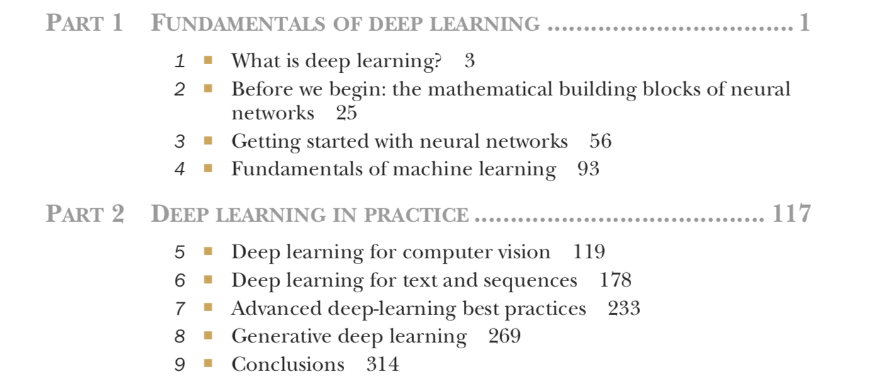
Timeplan
Sep 13 - Chapter 1-2
Sep 20 - Chapter 3
Sep 27 - Chapter 4
Oct 4 - Chapter 5.1-5.2
Oct 11 - Chapter 5.3-5.5
Oct 18 - Chapter 6.1-6.2
Oct 25 - Chapter 6.3-6.5
Nov 1 - Chapter 7
Nov 8 - Chapter 8.1-8.3
Nov 15 - Chapter 8.4-8.6
Nov 22 - Chapter 9

Slide 4
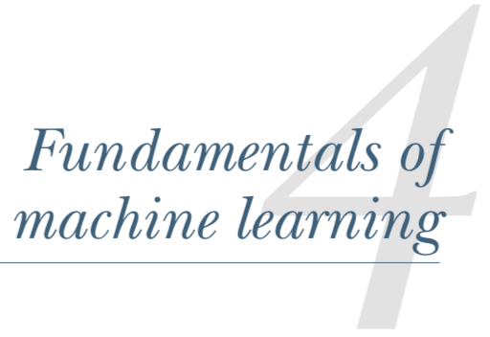
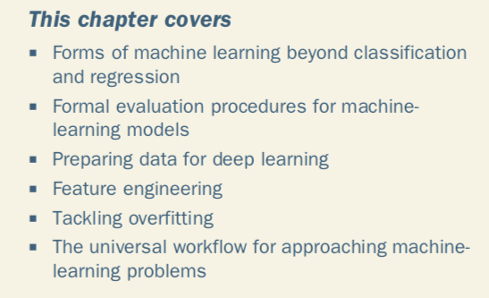
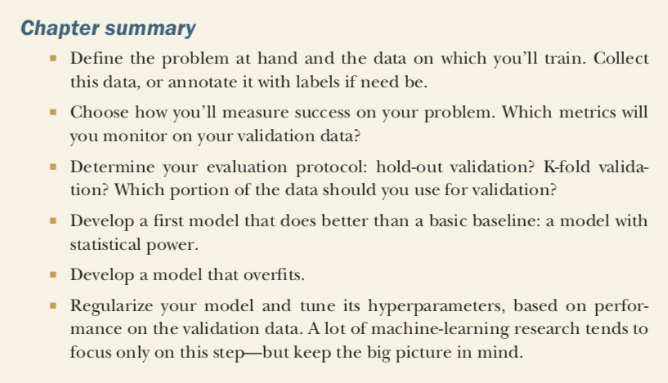

Slide 5
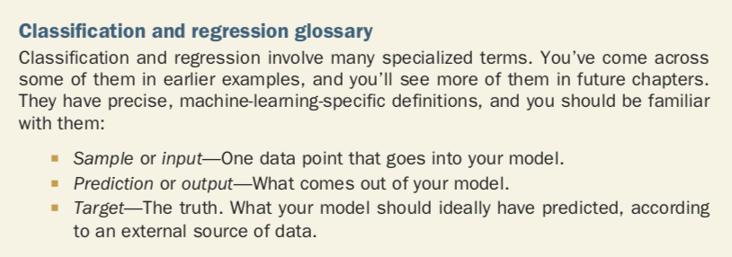
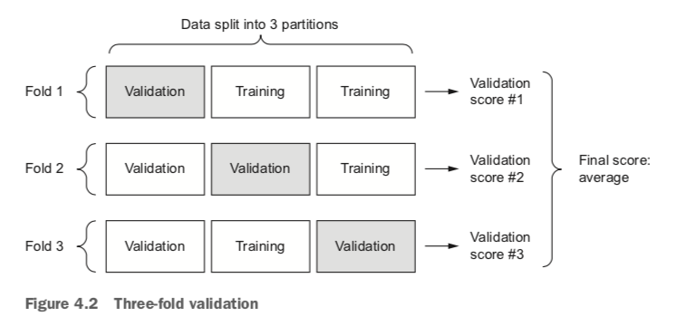
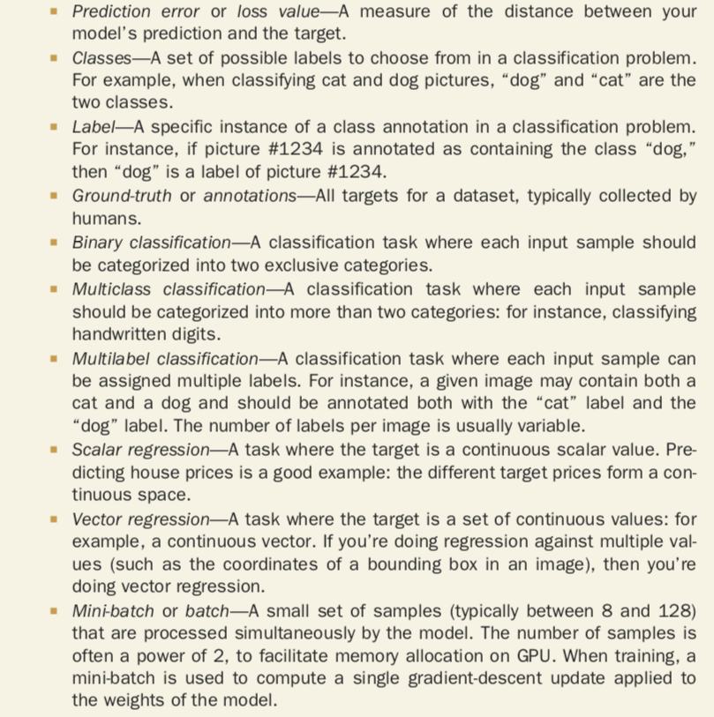
Classification and regression glossary
Training
Training

Slide 6
Group 1, Questions: 1, 5, 9, 13
1. How do you generate a training sample with added missing values? And what is best practice in .fillna() for DL? In more traditional modelling, dealing and preparing for missing values is included in the methodology. (Tomas Keller)
Does this question mean something else than Dropout method described with coding examples in chpater 4.4.3? Using fillna by grouping by another feature and then filling by missing features.
5. In Section 4.3.2 there is an example of how feature engineering can help interpreting the time of the day given an image of a clock. The section talks about "good features" and how the representation of data should make the model's job easier, which usually requires in-depth understanding of the problem. Now, in Chapter 2, in the MNIST example, we do what appears to be the opposite of feature engineering: reshaping the 28x28 image to a an array of length 784. Since the images come from actual pencil strokes on a sheet of paper, this recoding of the input seems to go in the opposite direction compared to encoding a clock face with say polar coordinates. There is of course no loss of information, but for a human it feels less natural to shred a drawing into a long strip of pixels. To us this would add an extra layer of "code cracking". My question is, how do we know what representations make the job of a neural network easier? Is there some kind of trial-and-error or best practice applied here? (Markus Jalsenius)
Feature engineering should not replace prediction done by ML algorithms. Use common sense for example to reduce and simplify features.

Slide 7
Group 1, Questions: 1, 5, 9, 13
9. Do you think that feature selection should have been given more focus in chapter four, perhaps as a standalone step? As far as I could read it was never mentioned as a separate step and was only included as a small optional step in the end (page 115) as part of the feature engineering. (David Norell)
Yes, we totally agree. This is part of ML competence.
13. In 4.5.1 it says that using machine learning trained on past data to predict the future is like making the assumption that future will behave like the past. Any good approaches for forecasting with DL? (Emil Svartström)
This issue does not prevent using historical data to predict future , but you need to be critical regarding results and be ready to tune the model if predictions deviate too much or stop using it altogether. Be aware of nonstationary problems – they cannot be solved by predictiosn based on histroy data!

Slide 8
Group 2, Questions: 2, 6, 10, 14, 17
2. How good are DL models to classify unseen observations with many extreme values? A normal decision tree have the logics to deal with this. (Tomas Keller)
(Janika Aan) It's known that modelling accuracy decreased as the percentage of outliers increased using neural network. Tree-based models are generally not as affected by outliers, while regression-based models are. (Janika Aan) Perturb data to simulate extreme or adversarial observations
6. In regards to evaluating your model, an important aspect in traditional data analysis is to evaluate feature importance, in order to e.g. detect troublesome features one should've excluded. What options are there for evaluating the effect of different features? Why isn't this mentioned in the "Universal workflow of machine learning"? (David Rydén)
(Team 2) As far as we know there is no such functionality out of the box within Keras, however there are secondary frameworks (e.g., Lime) that can return results related to e.g. feature importance. This is one of the challenges with deep learning, that it is usuallyhard to interpret how it's actually working. https://github.com/slundberg/shap

Slide 9
Group 2, Questions: 2, 6, 10, 14, 17
10. With weight regularisation a cost is added to the loss function. How do we ensure that this additive factor is not too large or too small? As I see it, a very large cost could render the actual loss function insignificant, and a too small cost would have too little effect. (Markus Jalsenius)
Same as on most questions.. Depends and testing is important. One can start with a model without weight regularisation and one with L1 or L2 with "Best practice" parameters of the weight regularisation. By trying to make it higher or lower one can see the impact.
14. In standard machine learning it is important to check that your features are not correlated to make sure you are using the correct model. For example you wouldn't use a CNN where you have a clear linear relationship in your features. Is this not as important in DL? (Sebastian Wolsing)
Multi colinearity affects the learning of Artificial Neural network. Since the information in the dependent variable is very less compared to the other variables, the neural network will take more time to converge. Source: https://datascience.stackexchange.com/questions/28328/how-does-multicollinearity-affect-neural-networks
17. It's mentioned that memorization can be achieved when the number of parameters > n_classes * n_samples. Is that a good rule of thumb even when applying regularization techniques such as dropouts and L1 or L2-regularization? Is there a way to get a value of the effective number of parameters? (Daniel Edsgärd)
Maybe add dropout into above formula. Leaves us with L1/L2-regularization. Found this discussion, related: https://stats.stackexchange.com/questions/181/how-to-choose-the-number-of-hidden-layers-and-nodes-in-a-feedforward-neural-netw

Slide 10
Group 3, Questions: 3, 7, 11, 15, 18
3. "The drop out rate is generally in the range 0.2-0.5". If 50% drop out gives good results, doesn’t that mean that the signal is very strong and/or the input values are highly correlated? To me it sounds strange to use that drop out frequency on hard problems. (Tomas Keller)
50% maximises the variability of possible network configurations. * Possibly due to a trade-off between the need of a deep network to represent certain features creating a network with many parameters, in combination with highly correlated features which requires high dropout rate. * Variability of model * Too low: overfitting, too high: underfitting
7. There are many ways to prevent overfitting but are there any best practices on when/what order to try which approach? E.g. for a certain type of problem dropout is usually the way to go and for other types of problems you are more likely to get better results with L1 regularisation etc. (Per Vingå)
* Possibly architecture, dropout is the most common in DL * Get more data
11. Is there a risk of data loss when normalizing values? Or does it even matter as long as the model is giving reliable results? (Vesa Turunen)
* No loss, inverse function recreates original data.

Slide 11
Group 3, Questions: 3, 7, 11, 15, 18
15. Chapter 4.4.3. Dropout method. Is a big dropout better choice than a small one or vice versa? What defines this, i.e. is there some theory behind chosing the optimal value or will this be done by trial and error? (Martti Kosonen)
See Q3.
18. One of the benefits with linear regression with L1-regularization (Lasso) is that the weights can get 0. Is that the case also for neural networks? (Daniel Edsgärd)
* Possibly, but even so, may not help interpretation.

Slide 12
Group 4, Questions: 4, 8, 12, 16
4. He writes about normalization of variables (mean 0 and std 1), a bit later he writes about missing values and "safe to input missing values as 0, with the condition that 0 isn't already a meaningful value. The network will learn that 0 means missing data". But when you apply normalization then 0 is the mean of the variable, hence it is meaningful and cannot be used to input missing values. What should be used to input missing values when 0 is a meaningful value? (Jorrit Peters)
You would put in the 0s prior to the normalization, so the "mean 0"s do not mean missing. Other tricks could be, prior to normalization, to replace missing with the average value, or one could run eg KNN or PCA and estimate the missing values (terribly much more work though..) or add another column which flags the missing. An example of the latter is databoost. One would have 2 columns, one would denote if the customer has the service databoost or not, the next column would be number of databoosts. Those whom do not have the service would have missing in this column, and one would keep the missings. (group in Norway)
8. Do you have any suggestion of resources to deep dive more into best practices of feature engineering in order to learn how to transform your inputs to a better representation for your learning algorithm? For regular machine learning problems and common domains (e.g., recommendation engines etc). (David Norell)
No. It is hard to think that there is any best practise as any feature engineering is utterly dependant on the case in question. Our suggestion is to know as many techniques as possible and then there is a lot of use of businness knowledge, trial and error.
12. A few times the importance of data shuffling was mentioned - in order not to have one type of data in training/ validation sets. But how does this shuffle kind of functions works? If the dataset is rather small does it insure that all kind of data is distributed evenly and will be split equally into different datasets? (Dovilė Momkutė)
We found shuffling mentioned only in connection with K-fold cross validation and iterated K-fold validation. In the first case the shuffling is probably to avoid any inadvertent ordering in the dataset. In the next case the shuffling is done between each K-fold run so that each run can be viewed as independent of each other, thereby retaining statistic properties, no bias between each run etc. Janika: huffling data serves the purpose of reducing variance and making sure that models remain general and overfit less. For small dataset it's good to use Leave One Out Cross Validation (LOOCV). This method is very computationally expensive and should be used on small datasets. If the dataset is big, it would most likely be better to use a different method like random (random.shuffle in python) or K-Folds Cross Validation. LOOCV is one of the common type of cross-validation: https://en.wikipedia.org/wiki/Cross-validation_(statistics)#Leave-one-out_cross-validation Python random.shuffle assumes a good random number generator. It uses Fisher-Yates shuffle: https://en.wikipedia.org/wiki/Fisher%E2%80%93Yates_shuffle

Slide 13
Group 4, Questions: 4, 8, 12, 16
16. The issue of data redundancy is mentioned which increase the risk of memorization. Is that an issue if the true underlying population has the same pattern of redundancy? How would you handle closely correlated observations? Should one then typically always investigate the correlation matrix and choose a representative per cluster? (Daniel Edsgärd)
In our group, we were not certain about this. From before we know that binary correlations will give issues in "standard" regressions due to that one at some point ends up dividing by 0 (think of regressions as matrix multiplications and divisions, binary correlations correspond to determinants=0 and division by 0). One could also think of "hyper correlations": where binary correlations correspond to a line, one could have trinary correlations corresponding to a plane and so forth - then one would go to eg Principal Components to ensure uncorrelated features also in higher dimensions. But in DL where one introduces nonlinearities through the activation functions, this may not be a problem at all. We are simply not sure. (group 4 in Norway) * Look into active learning

